Slide 1
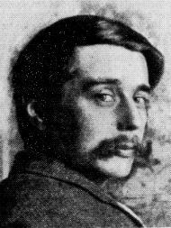
“
Civilization is in a race between education and catastrophe.
Let us learn the truth and spread it as far and wide as our circumstances allow. For the truth is the greatest weapon we have.
~H.G. Wells
Notes:
We have the big picture now

Slide 2
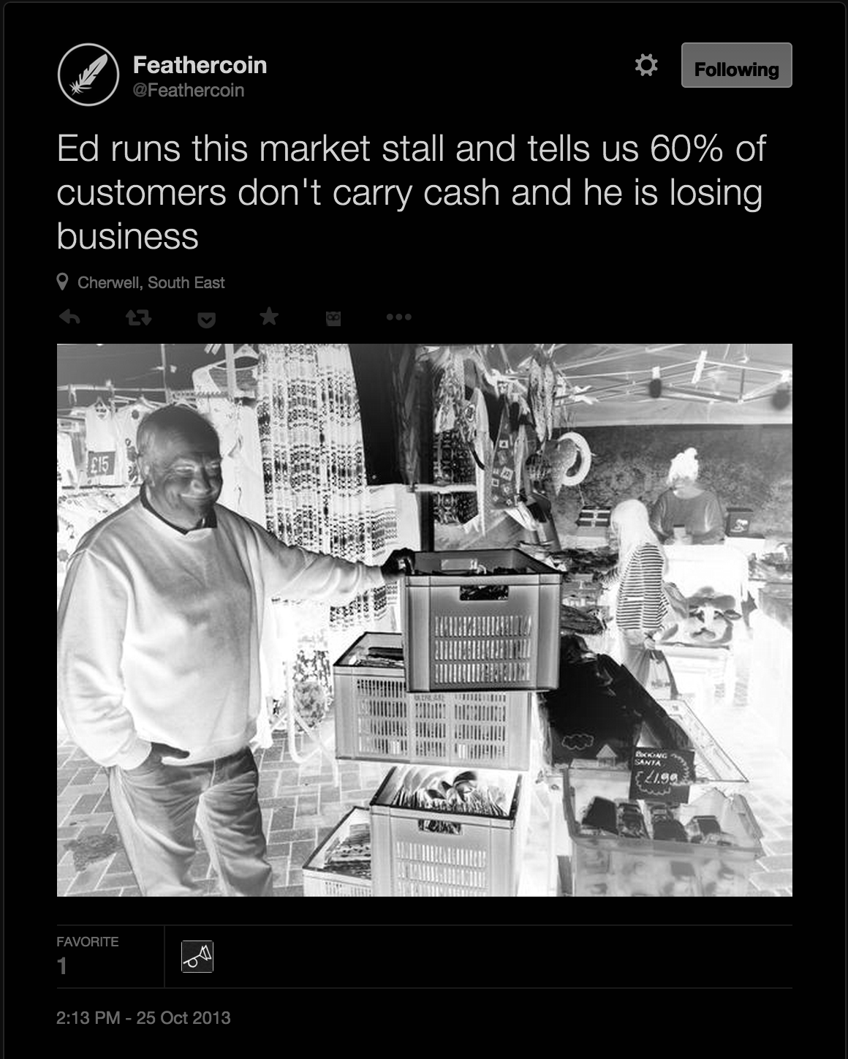
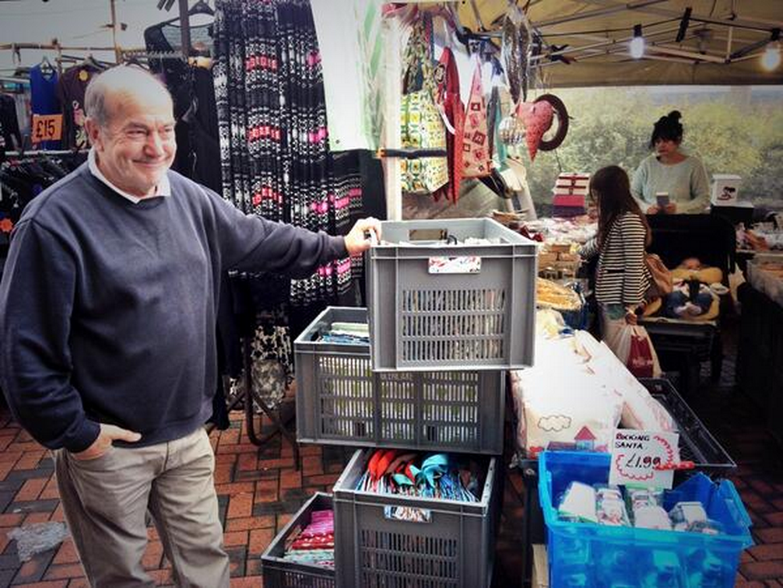
What I learned:
It’s not the money we want,
It’s each other
It’s where it takes us
Help me have impact
Help me be relevant
Help me make my contribution
Notes:
We try to feature news on the ground and get to the local issues.
Currency has been digitised now for 30 years

Slide 3
Merkle Root
18e44f11e94a586c6f0a838ad92cb8b061b6f873e1c56635618bf84bca63eab7

Slide 4
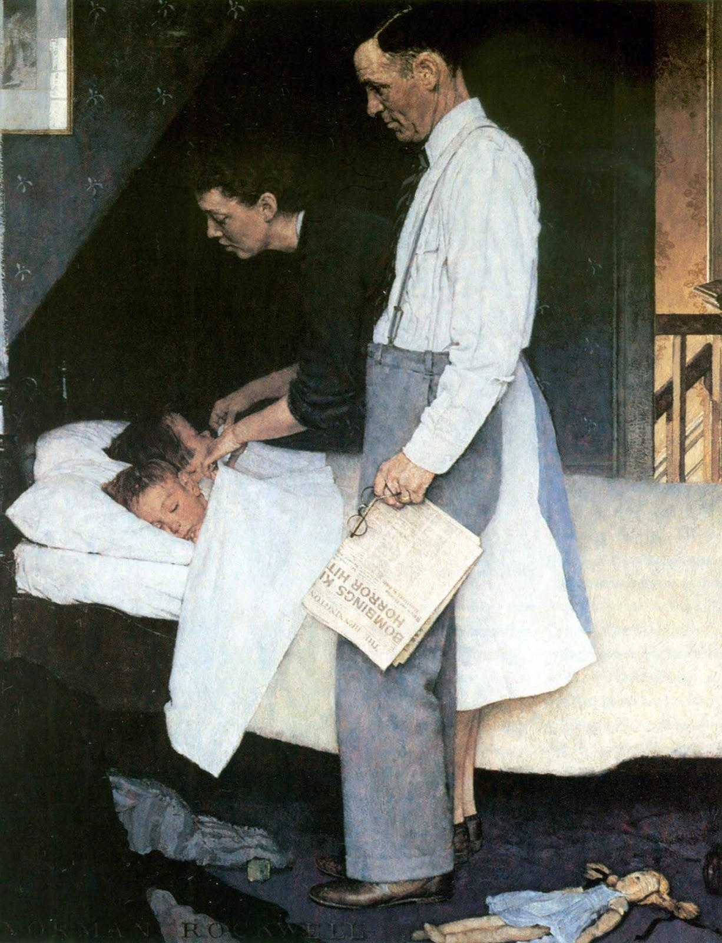
Norman Rockwell's Freedom from Fear 1943
Notes:
Talked about in Peace and Bitcoin: https://www.youtube.com/watch?v=Fn-SpMrTuyI
Norman Rockwell's Freedom from Fear

Slide 5
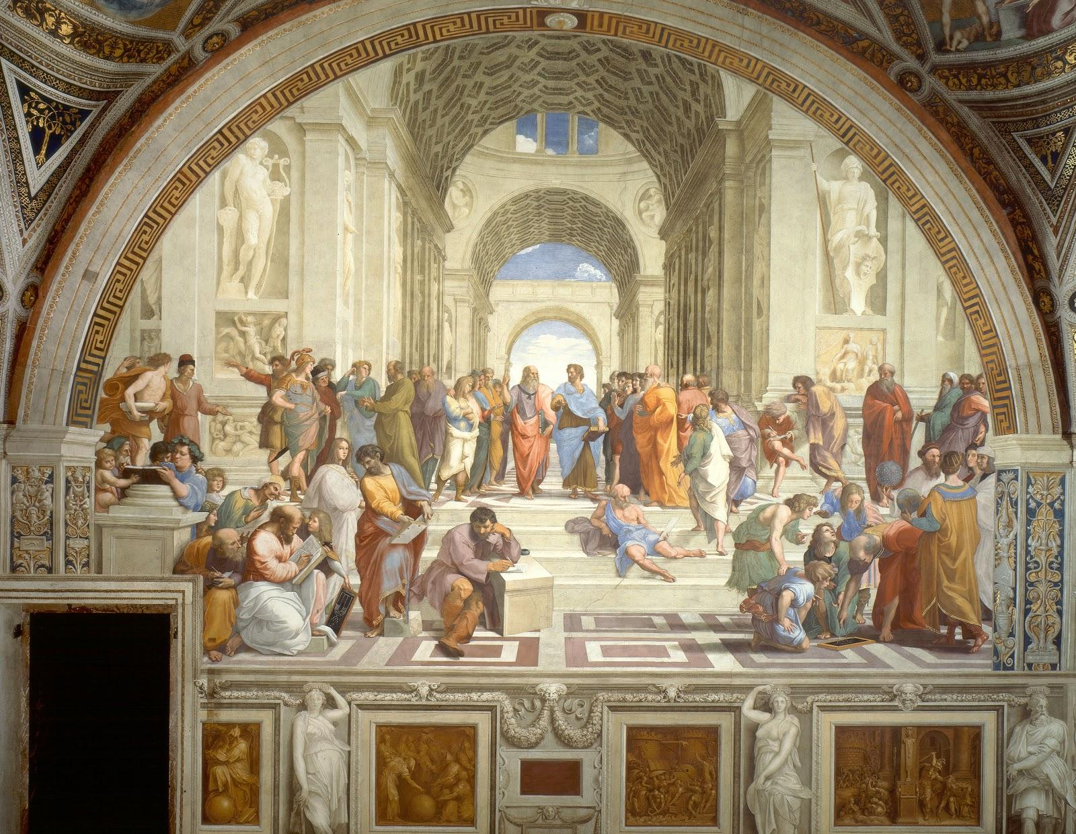
Basic Concepts
The sophos (the experts) & the demos (the people)
The episteme (knowledge) and the doxa (opinion)

Slide 6
Underlying Assumptions
Defining definition
To demarcate
Minimax occam
Defining Entrepreneur
The ability to anticipate demand
Well performing entrepreneurship is recognised
Defining Business
A sequence of activities
Defining Profit
Progress
Risk is distributed
In short: whose ideas get to be brought in to the material world?
Who gets the land, the money, the food, the security
The internet is an interconnected network
It networks networks

Slide 7
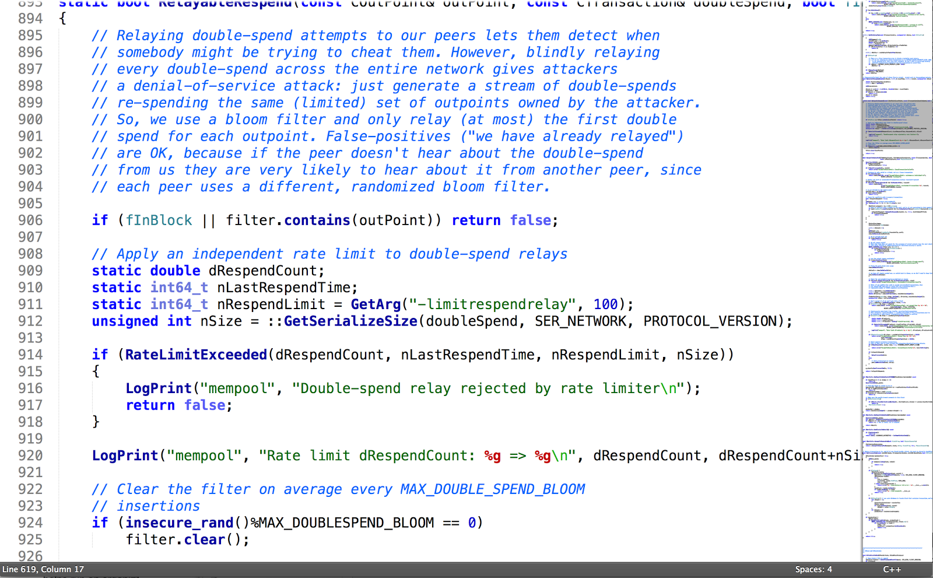
The regulation is in the code and the community
Notes:
This is the denationalisation of money
The code is the law, the enforcers are the public
It represents digital scarcity. When I used to communicate

Slide 8
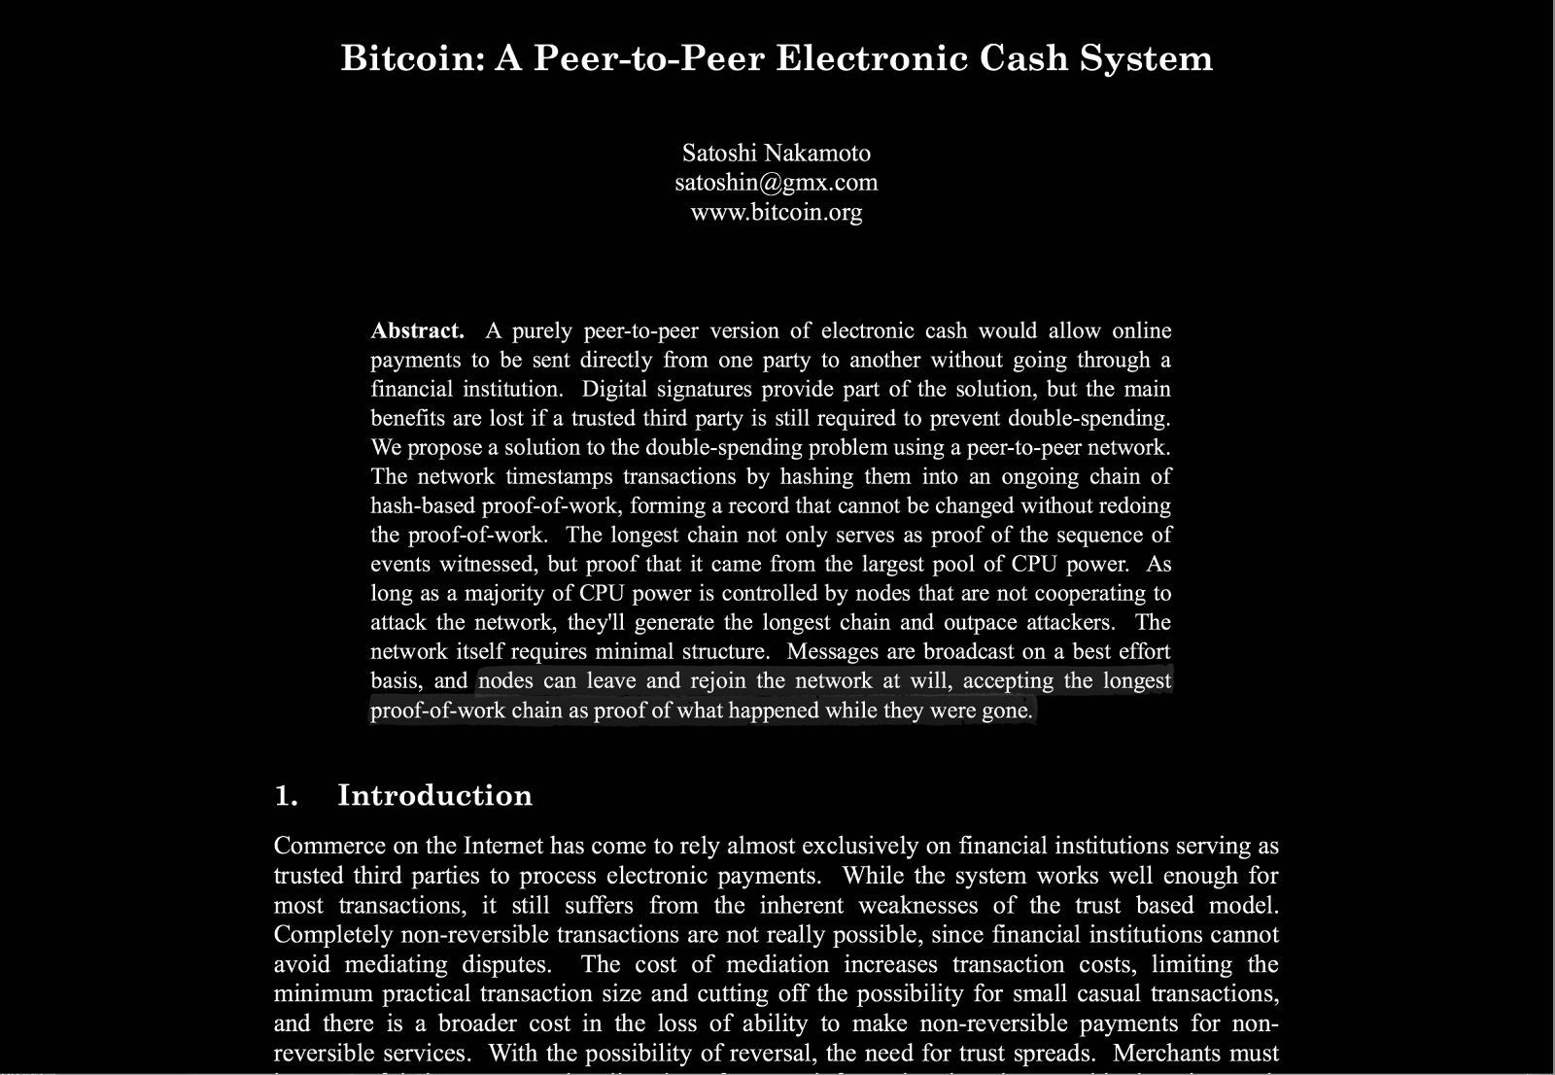

Slide 9
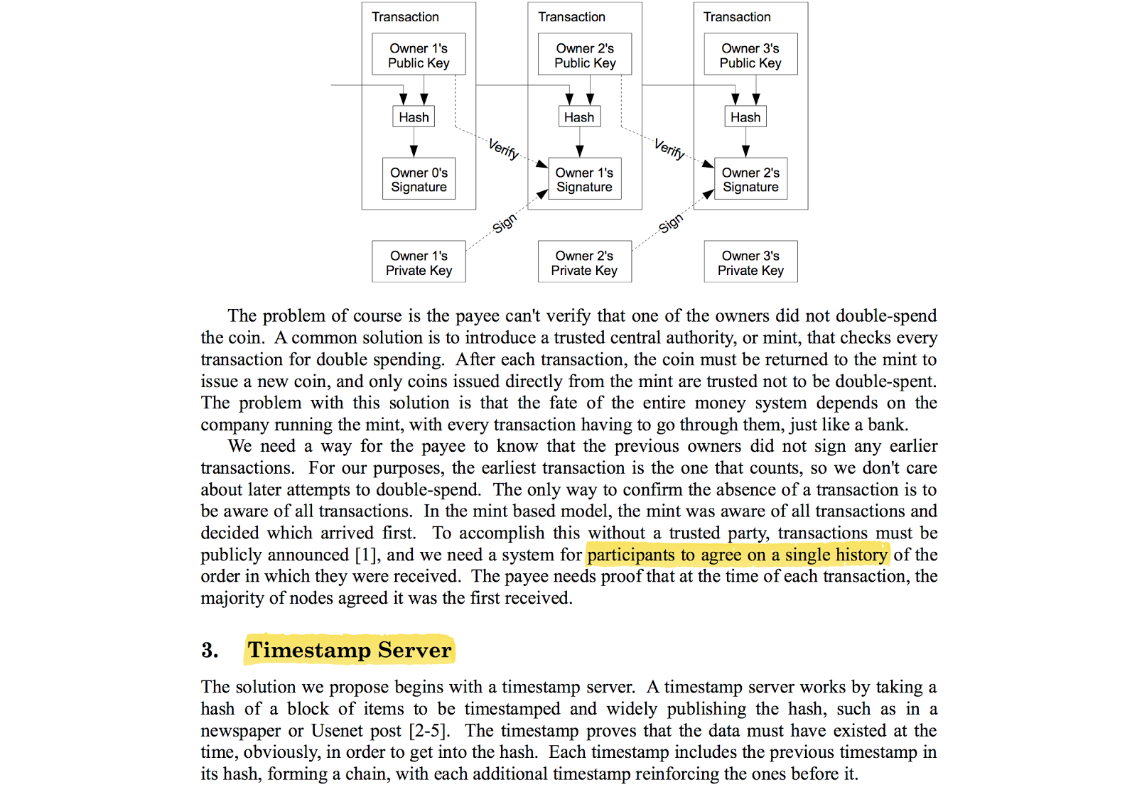

Slide 10
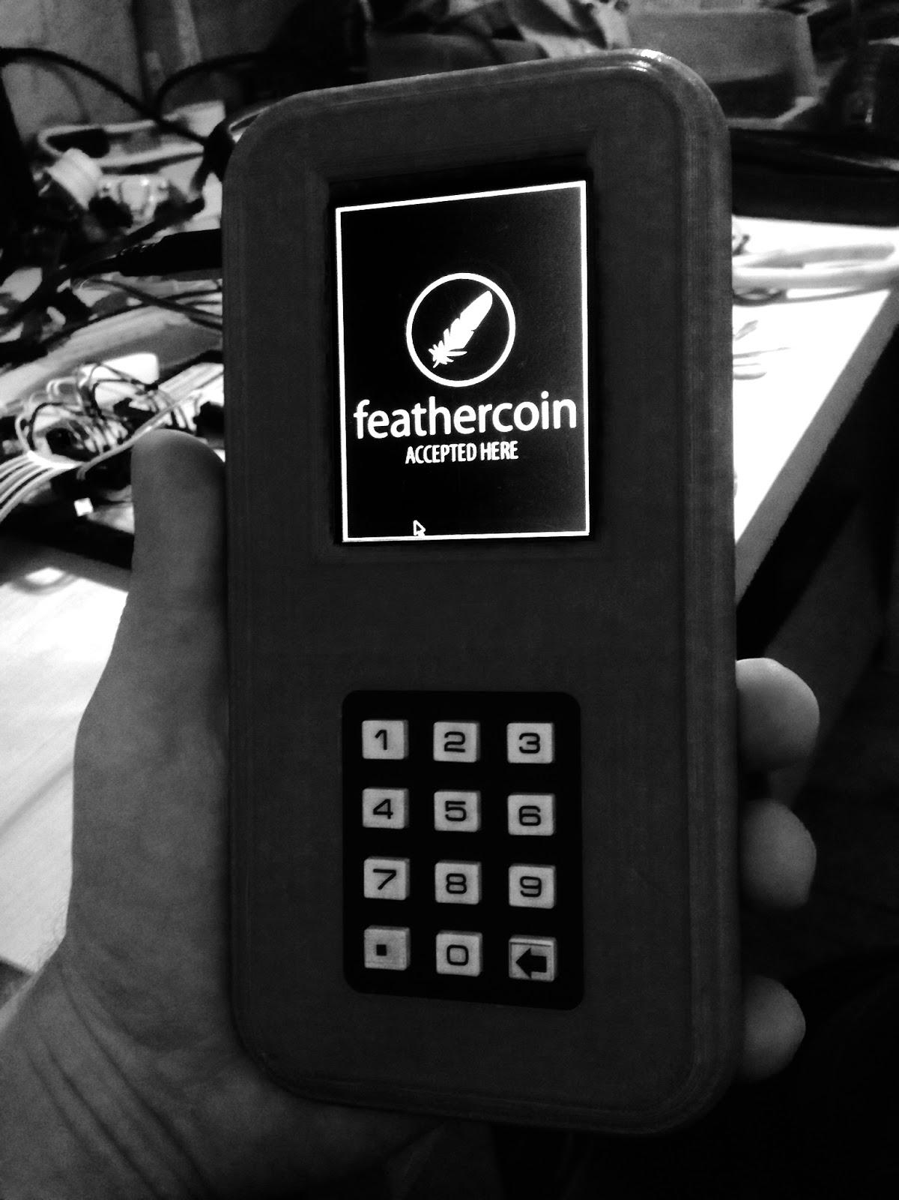
Feathercoin Point of Sale
Notes:
The case is made from a 3D printer, inside it’s a Raspberry Pi

Slide 11
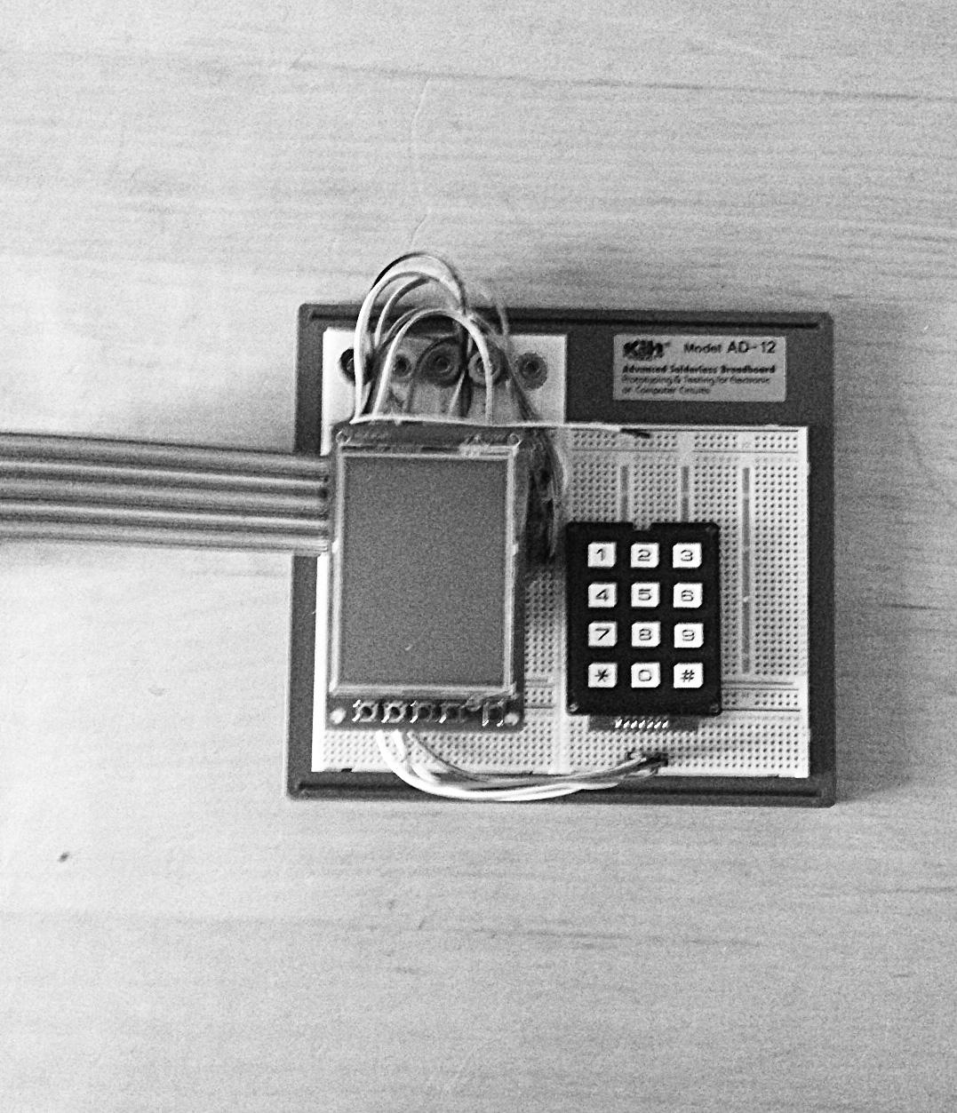
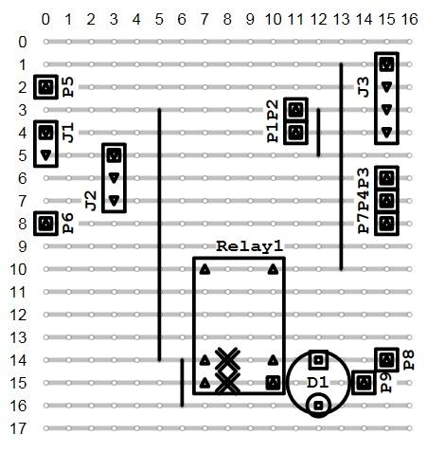
Hardware is Open Source

